Slide 1
Random Forest (RF)
Md. Golam Rabiul Alam
Associate Professor, BRAC University

Slide 2

Random Forest
Random forest is a decision tree based non-linear machine learning model for classification, regression and feature selection.

Slide 3
Random Forest
The word “Random” is for random selection of data instances, which is known as bootstrapping method in statistics an ML as well.
The word “Forest” is for using several decision trees in developing decision models through bagging method.

Slide 4
Random Forest
Steps in Random Forest Classification Method:
1. Bootstrapping for random data subset generation
2. Decision tree construction for each of the data subset
i) Determination of GINI impurity of each of the features.
Ii) Determination of GINI impurity of prospective splitting sub-tree
Iii) Construction of Decision tree based on the splitting GINI impurity (i.e. if sum of the GINI impurity of splitted sub-tree is lower than the GINI impurity of parent node then split the parent node)
3. Bagging for ensemble classification
4. Majority voting for classification decision making.

Slide 5
Random Forest
GINI Impurity:
The GINI Impurity of a node is the probability that a randomly chosen sample in a node would be incorrectly labeled if it was labeled by the distribution of samples in the node.
The GINI impurity can be computed by summing the probability p_{i} of an item with label i being chosen times the probability of a mistake in categorizing that item.
It reaches its minimum (zero) when all cases in the node fall into a single target category.

Slide 6
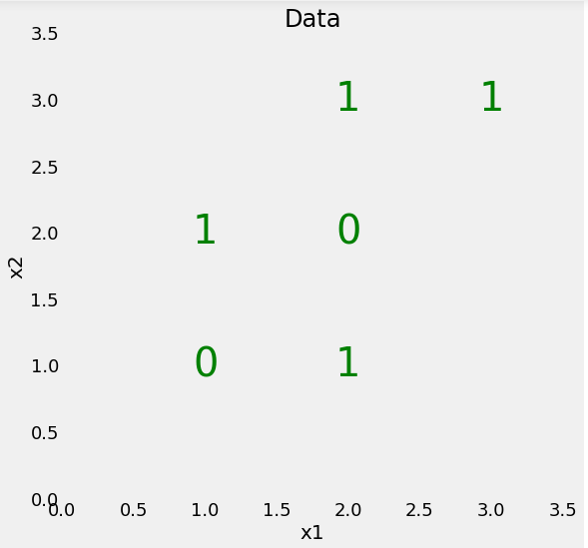
Random Forest
Find the GINI impurity from the given date?

Slide 7
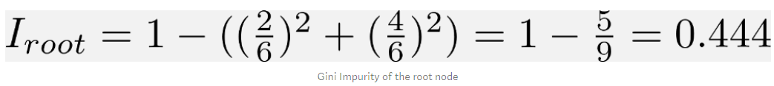
Random Forest

Slide 8
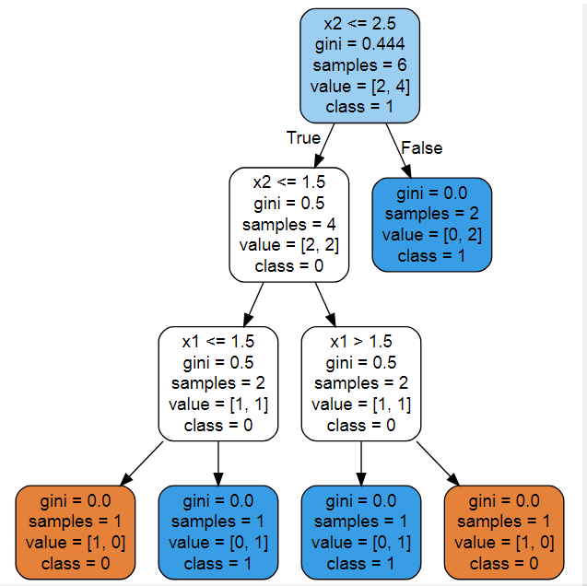
Random Forest
How to split the root node? Which splitting is better?

Slide 9
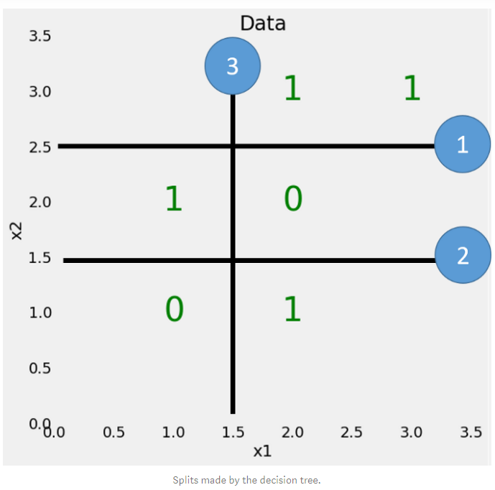
Random Forest

Slide 10
References
INTRO TO RANDOM FOREST, by ANTHONY ANH QUOC DOAN
StatQuest: Decision Trees
https://www.youtube.com/watch?v=7VeUPuFGJHk
StatQuest: Random Forests Part 1 - Building, Using and Evaluating
https://www.youtube.com/watch?v=J4Wdy0Wc_xQ

